Slide 1
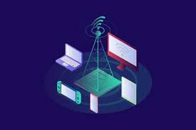
Tinkering Lab GE107 PG-15 LoRA Device
Purab: 2022CHB1055
Vedang: 2022CHB1056
Sayed: 2022CHB1057
Tanishk: 2022CHB1058
Tushar: 2022CHB1059
Vikas: 2022CHB1060

Slide 2
TABLE OF CONTENTS
01
PROJECT BRIEFING…
02
Parts Description…
03
Procedure…
04
Codes…
Short Intro
The basic working of the whole projec in a short way

Slide 3
INTRODUCTION
We are going to prepare a LoRA(Long Range Device) which is a wireless modulation technique derived from Chirp Spread Spactrum technology.
By using this we are able to send text messages from one device to another without using Internet, Bluetooth or Wire connections between the devices.
The device is able to send messages ranging from 1 to 15kms within the few milli seconds. Arduino LoRa Free SMS over Long distance without GSM Network– In this, you will learn how to send free SMS or text messages over long distances using Arduino boards, a pair of SX1278 LoRa Transceiver modules, a pair of HC05 or HC06 Bluetooth modules,and a pair of smartphones with my designed android Application installed in.
With my designed project, you don’t need a GSM network to send and receive free SMS or messages. We will exhibit how to use long-range LoRa transceiver modules for sending free SMS.

Slide 4
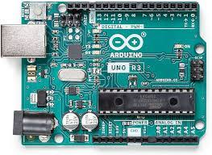
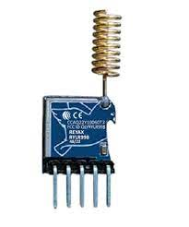
Parts Description
Arduino
LoRA Module
The Arduino Uno is an open-source microcontroller board. The microcontroller board is equipped with sets of digital and analog input/output (I/O) pins.
LoRa is a physical proprietary radio communication technique.It is based on spread spectrum modulation techniques derived from (CSS) technology.

Slide 5
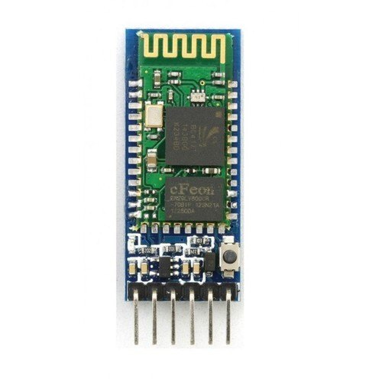
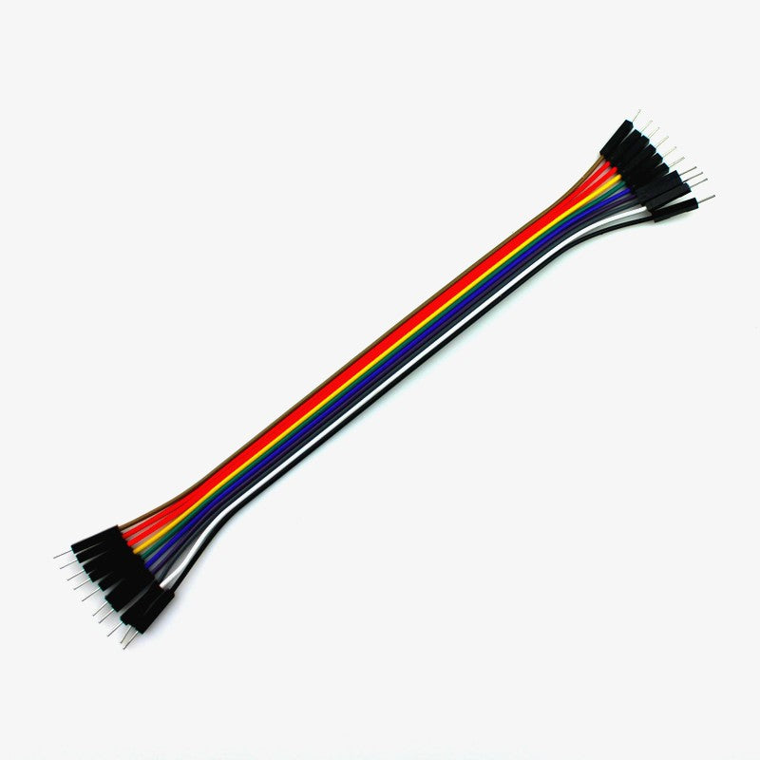
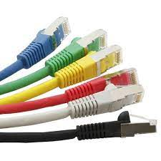
HC-05 Bluetooth module
Wires
Cables
For connections.
It is used as UART serial converter module and can easily transfer the UART data through the wireless bluetooth
Theses are used for the connections.

Slide 6
Procedure
For understanding the concept conveniently, I will term one of the sides as User 1, while referring to the second side as User 2. You can design similar circuits for other users as well by means of making such connections. Thus, more and more people will get in touch and would be able to communicate and interact.
Anyways, I will opt to continue just with User 1 and User 2 for demonstration purposes. User 1 can both send as well as receive messages, likewise, User 2 can also send as well as receive messages.
The working of this project is pretty simple. First, a message is transmitted to Bluetooth from a smartphone and then Bluetooth forwards it to Arduino. Then using LoRa, Arduino sends this message wirelessly to the remote side LoRa module “user2 side”.
On the other side, Arduino receives a message from LoRa, and then forwards it to the smartphone application through Bluetooth. Exactly the same process will be carried out on the User 2 side.

Slide 7
KEY FEATURES
Sending Messages to each other without any extra charges or fares as in normal messages
Without using any WiFi or Bluetooth or Gsm network we send and receive message
Very less requirement of components and infrastructure’s cost and very much friendly.

Slide 8
Circuit Diagram

Slide 9
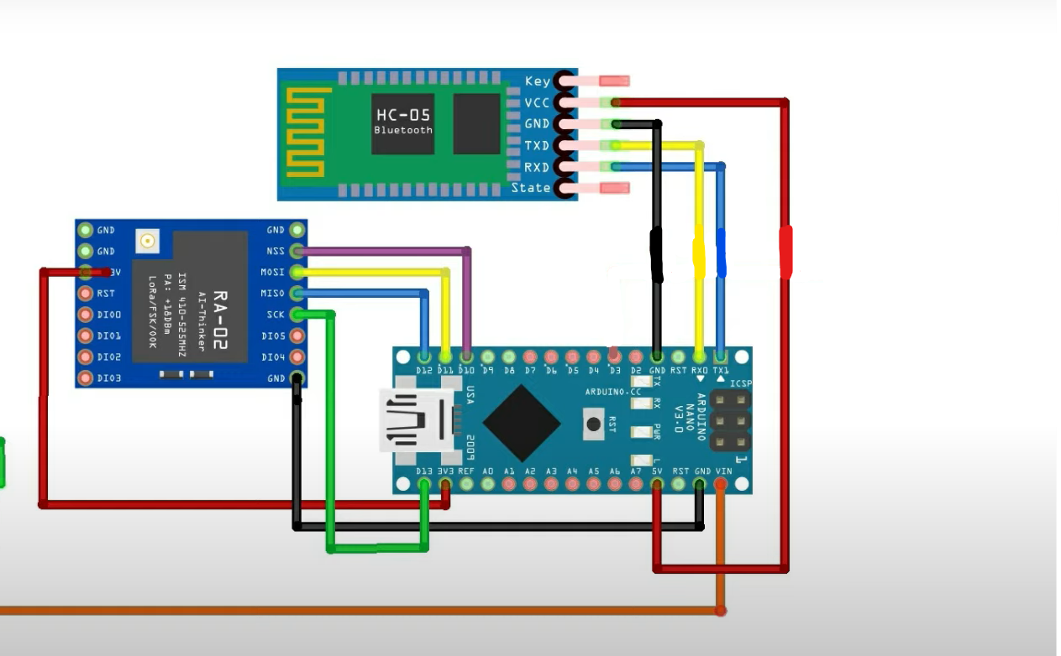
PRODUCT DEMO
The VCC of the LoRa module is connected with the 3.3V of the Arduino. The MISO Pin of the LoRa module is connected with the Arduino pin 12. The MOSI pin is connected with pin 11. The SCK pin of the LoRa module is connected with pin 13. The NSS pin is connected with the Arduino’s pin 10 and the ground pin of the LoRa module is connected with the Arduino’s GND.
The VCC and GND pins of the HC05 Bluetooth module are connected with the Arduino 5V and GND pins. While the TXD and RXD pins of the Bluetooth module are connected with the RX0 and TX1 pins of the Arduino Nano.

Slide 10
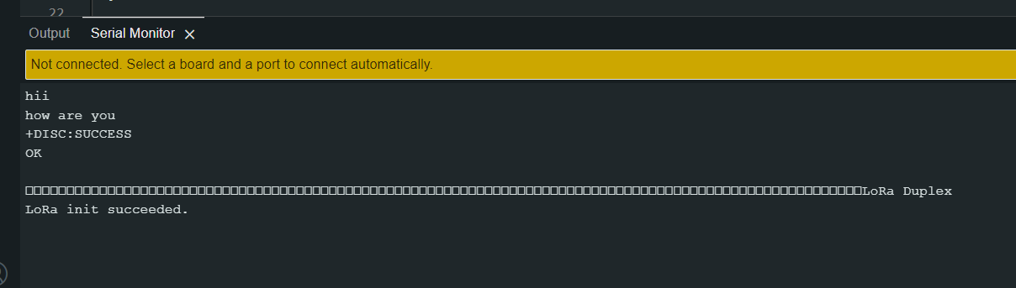
Working Demonstration

Slide 11
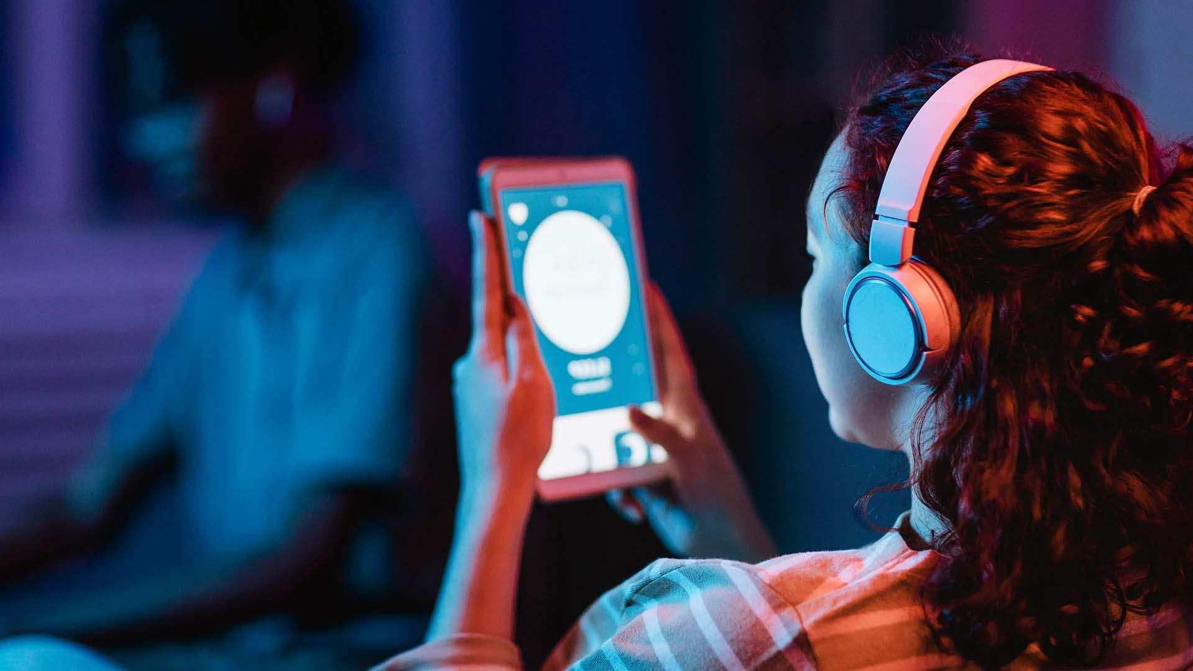
Thank You

